Slide 1

Work Vessels For Veterans
By: Duy, David, Mateusz, Adam

Slide 2
Mission and Vision Statement
Mission:
Provide critical equipment to America’s injured veterans to help them start businesses or pursue career education.
Empower veterans with flexible, self-employment solutions that accommodate medical challenges and personal needs.
Vision:
Every injured veteran will have access to the tools and resources needed to achieve economic independence and contribute to their communities as entrepreneurs.

Slide 3
Overview
Founded in 2008 by John Niekrash
Established to provide equipment to injured veterans, enabling them to start businesses or pursue career education.
Over 3,000 injured veterans assisted since inception.
Operating in all 50 states and U.S. territories.
More than $4 million in equipment distributed to veteran enterprises.
Over $22 million in economic activity generated by veteran-led businesses.
Programs include providing critical equipment, peer-to-peer mentorship, and fostering entrepreneurship among veterans.

Slide 4
Programs
Veteran Entrepreneurship
Equipment grants for veteran-led businesses
Peer-to-peer mentorship with experienced veteran entrepreneurs
Creative solutions for adaptive equipment
Career Support
Assistance with career education resources
Volunteer-matching program for professional guidance
Networking opportunities for veterans to connect with business leaders
Economic Impact Programs
Support for creating new businesses and job opportunities
Collaboration with corporate partners for in-kind donations
Follow-up services to ensure business sustainability
Recognition and Advocacy
Highlighting veteran success stories to inspire others
Advocating for injured veterans through national and local networks
providing resources for public awareness about veteran entrepreneurship challenges and

Slide 5
Operations & Data Management Overview
Donor Management
Currently managed through a web-based system interfaced with the organization’s website.
Tracks donor information, donations, and engagement to support fundraising and transparency.
Finances
QuickBooks is used for financial management.
Daily data entry and updates are managed by the office manager.
Monthly audits are conducted by a Certified Public Accountant to ensure accuracy.
Program Delivery
Data for programs is tracked using various Excel sheets.
A simple Excel dashboard is used by leadership to monitor program metrics.
Manual updates are required for each sheet and the main dashboard.
Updates occur monthly, leading to limited real-time data availability.

Slide 6
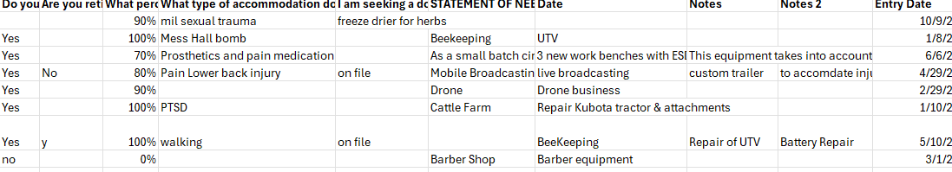
Current Database Examples

Slide 7
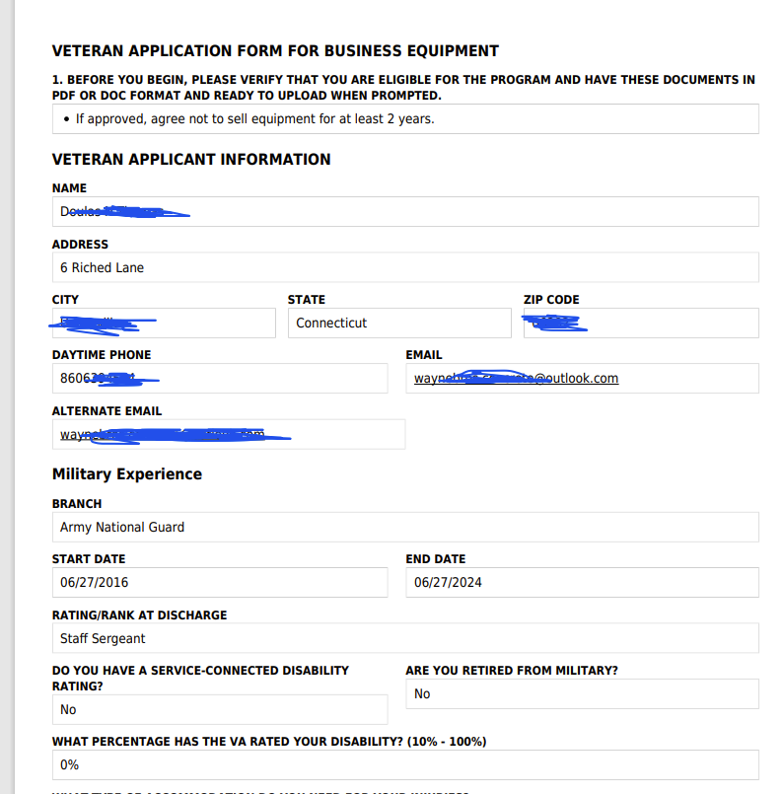
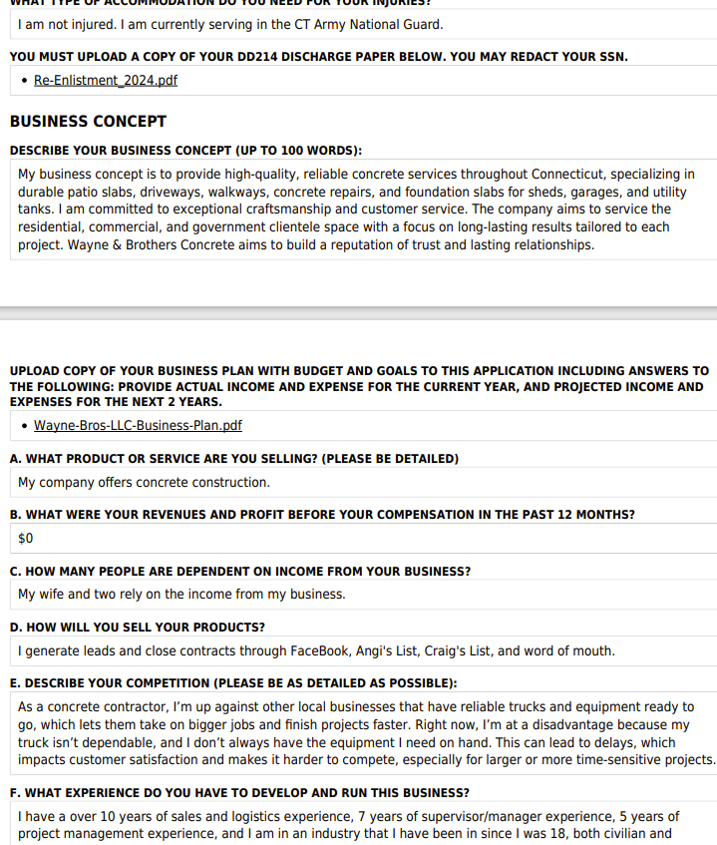
Veteran Application Form Example

Slide 8
Specific Business Problem Statement
Work Vessels for Veterans (WVFV) aims to empower injured veterans by providing essential equipment and support for business ventures or educational pursuits. However, WVFV faces challenges with its current data management:
Fragmented Systems: Utilizing separate platforms for donor management, finances, and program data hinders comprehensive analysis.
Manual Processes: Reliance on manual data entry increases the risk of errors and delays.
Limited Real-Time Access: Monthly updates restrict timely insights into operations.
Scalability Issues: Current methods struggle to support operations across all states and territories.
Volunteer Matching Challenges: Lack of a streamlined digital solution complicates volunteer coordination.
Addressing these issues is crucial for WVFV to enhance efficiency and better serve veterans.

Slide 9
Benefits of New Data System
Centralized Data Management: Ensures all organizational data is stored and managed in one place, reducing redundancy and enabling better accessibility.
Real-Time Insights: Provides immediate access to updated data, facilitating timely decision-making and quick responses to changes.
Improved Accuracy and Efficiency: Reduces human errors and automates processes, enhancing operational productivity and reliability.
Enhanced Donor Engagement: Offers personalized communication and tracking, improving relationships with donors and increasing satisfaction.
Streamlined Program Delivery: Simplifies program planning and execution by integrating workflows and improving coordination across teams.
Scalability: Allows the system to grow with the organization, accommodating increasing data volumes and user demands seamlessly.

Slide 10





Solution
Proposed Solution:
Centralized, cloud-based database system.
Automates data entry, reporting, and tracking.
Integrates all key operations.
Key Features:
Real-time data tracking and reporting.
Streamlined volunteer-to-veteran matching.
Automated financial and impact reporting.
Expected Benefits:
Reduces manual errors and delays.
Improves donor engagement and transparency.
Enables real-time insights into veteran outcomes.
Data Input
Centralized System
Real-Time Analytics
Automated Reporting

Slide 11
Business Case
Work vessels for vets enables disabled vets to start entrepreneurial ventures by awarding them start-up capital / equipment if they qualify and submit a compelling application. The application requires vets to input this information: name, state , phone # , email , branch of military served in, serve start date , serve end date , disability , VA rating of your disability and today's date. Then the veterans need to fill out a proposal request which requires this information: The requested money/resources , business type, and a link to an in-depth business plan. An applicant can submit many proposals. Work vessels needs a way to organize this data and make insights from it.

Slide 12
Initial ER Diagram
Application
App ID
Name
State
Phone #
Email
Branch
Serve start date
Serve end date
Disability
VA rating
Submission date
Proposal
Proposal ID
Request amount
AppID
Business type
Proposal link
Awarded amount
Evalution status
Resources
Resource ID
Proposal ID
Description
Awarded

Slide 13


Relations
Applications
(AppID, Name, State, Phone#, Email, Branch, Serve start date, Serve end date, Disability, VA rating, Submission date)
Proposal
(PropID, AppID, Request amount, Business type, Proposal link, awarded amount, Evalution status)
Resources
(ResourceId, ProposalID, Description, Awarded)

Slide 14
Final ERD
Application
Proposal
Resources

Slide 15
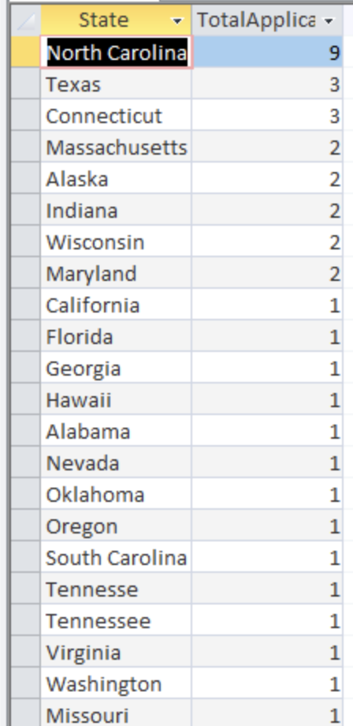
Query 1
SELECT State, COUNT(AppID) AS TotalApplicants
FROM APPLICANT
GROUP BY State
ORDER BY COUNT(AppID) DESC;
This query identifies the number of applicants by state, helping the organization allocate resources effectively. It highlights regions with higher demand, like North Carolina, Texas, and Connecticut, allowing for targeted outreach and strategic planning to optimize support and resource distribution.

Slide 16
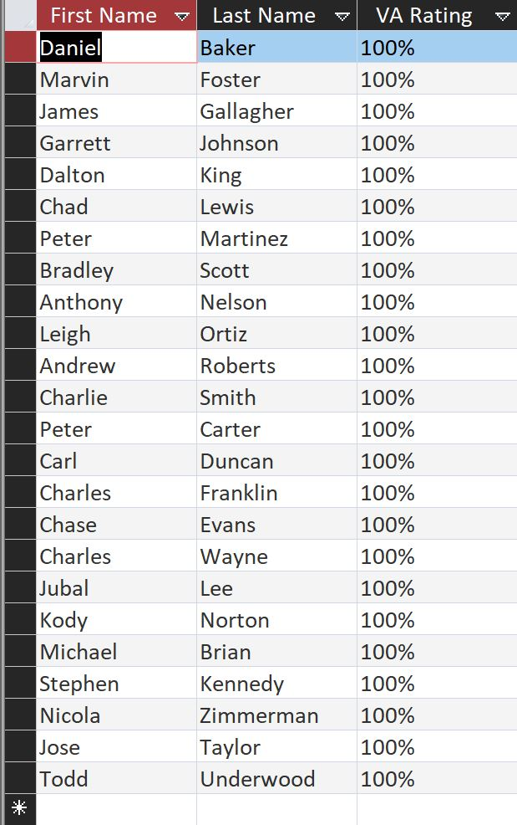
Query 2
SELECT [First Name], [Last Name], [VA Rating]
FROM APPLICANT
WHERE [VA rating] = '100%';
This query separates individuals with a 100% Veteran Affairs (VA) rating from the rest. A 100% VA rating indicates that they are fully disabled due to service-connected conditions, making them a priority for receiving resources and support from the Work Vessels for Veterans programs.

Slide 17
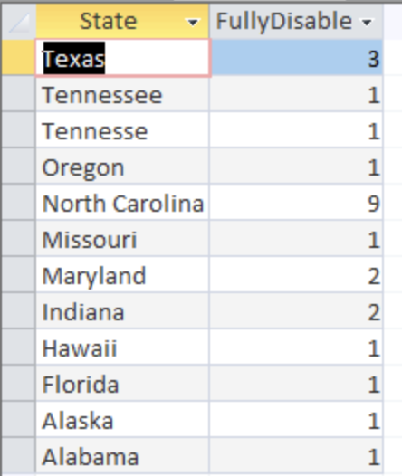
Query 3
SELECT State, COUNT([VA Rating]) AS FullyDisabledCount
FROM APPLICANT
WHERE [VA Rating] = '100%'
GROUP BY State
ORDER BY FullyDisabledCount DESC;
This query identifies the number of fully disabled veterans (with a 100% VA rating) in each state. By organizing this data, the organization can prioritize states with the highest number of fully disabled veterans, ensuring resources are allocated where they are needed most

Slide 18
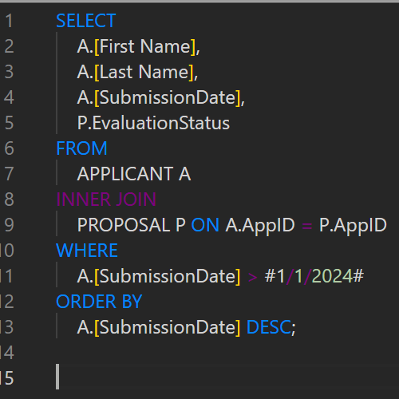
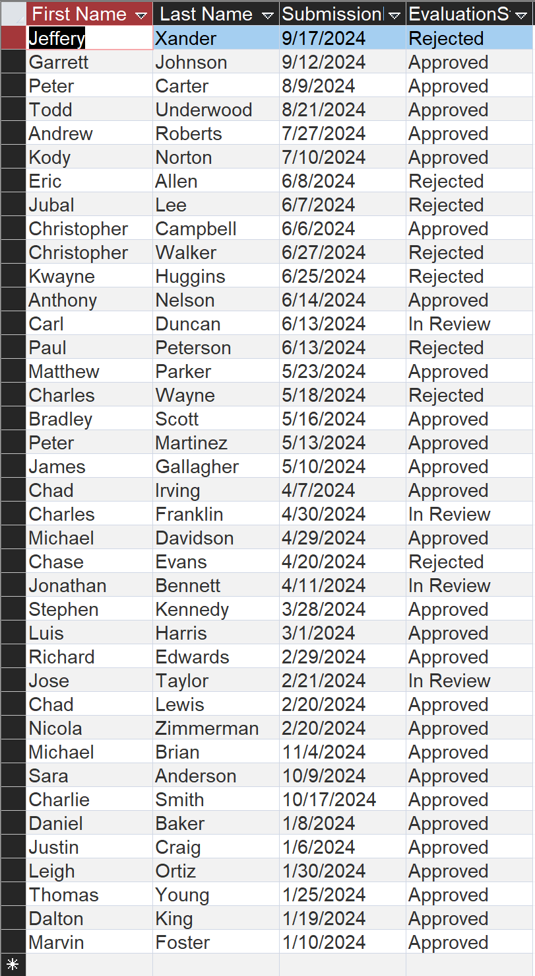
Query 4
This query retrieves applications submitted after a specific date, making it easier to focus on recent applicants. It helps ensure timely follow-ups, allowing staff to address needs quickly and prioritize newer submissions without delays. This process keeps the workflow organized and ensures no recent application is overlooked.

Slide 19
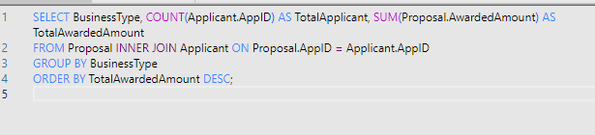
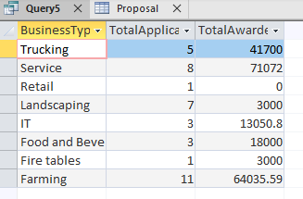
Query 5
This query shows the total applicants and total awarded amounts by business type, helping the organization understand where most funding is directed and if it aligns with applicant needs. For example, higher funding for trucking and service businesses may reflect higher startup costs. This information also provides transparency for donors, showing how their contributions make an impact across different industries.

Slide 20
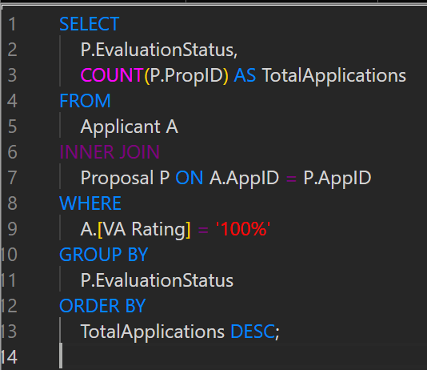
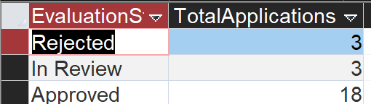
Query 6
This query identifies the number of fully disabled applicants whose proposals were approved or rejected, providing valuable insights for the organization to assess their needs and offer support. As individuals who have served our country, it is essential to explore ways to assist them effectively, ensuring they receive the recognition and resources they deserve. By understanding these approval and rejection rates, the organization can refine its processes and allocate resources to better support fully disabled veterans in achieving their goals.

Slide 21
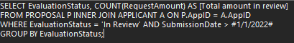
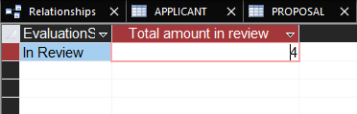
Query 7
This query shows the number of cases that are in review after a certain date. It can be used to check how many case are in review for the year 2024. It can also be used to select the number of case in review before 2024 which can be helpful in prioritizing cases.

Slide 22


Query 8
This query shows the total amount requested and the total amount approved after 1/1/2024. This can be used to assess how much the organization has given out in total and calculate approval ratio.

Slide 23

Query 9
Updating information is extremely important but often overlooked. We strive to ensure all records are accurate and up to date for all applicants. A veteran recently notified us of a change to their contact details. Please update the phone number for Luis Harris to 817-753-1242.

Slide 24

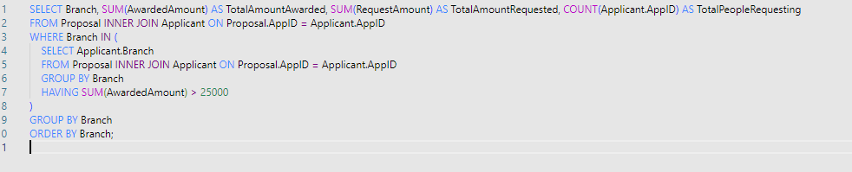
Query 10
This query gives us the sum of the awarded amount per military branch while only displaying the branches that exceeded $25,000 in awards. This helps the organization see what branch is receiving the most in awards and which ones aren’t receiving that much. The organization could then extrapolate this information and say that these branches are receiving the highest level of financial support, potentially demonstrating a higher level of need. Another reason could be that these branches are more effective in their proposal submissions.

Slide 25
Revisions according to feedbacks
Deleted slide 12 and replaced it with the current slide 11
Made changes to slide 7
Query 4 added evaluation status (approved, rejected, reviewing)
Query 5 added total applicants and total awarded by state instead of average reward
Query 10 added total requested amount and counted the number of applicants that requested that amount
Query 8 added in Submission date to select data from a certain time period.
Query 7 added Submission date into query to select in review cases from a certain time period. This helps decide which cases to prioritze.
In the database, changed the evaluation status to partially approved if the requested amount wasn’t fully rewarded, fully approved if the requested amount was fully approved, or rejected if rejected.
In the database changed the resources table to show two different resourceids for the same propid. For example, one propid could have been awarded both a truck and money so I changed it to have two different resourceid but the same propid

